Slide 1

SALARY PREDICTION OF AN EMPLOYEE Project Synopsis Presentation Date: 05/01/2022
Industrial Training
Degree : BCA
Project Guide:
Mrs.Rohaila Naaz
Presenter Name:
Ayush Jain (TCA1901063)
FACULTY OF ENGINEERING & COMPUTING SCIENCES
TEERTHANKER MAHAVEER UNIVERSITY, MORADABAD

Slide 2

Team Details
Student Name | Role
AYUSH JAIN | Working on Datasets
Guidelines: Mention Team Names & their role in project
2
T011A/ Template Version 5.0

Slide 3
Project Brief
Machine learning is the subset of artificial intelligence, using machine learning we build algorithm or models which can predict future output and results based on past experience and trained dataset. By different output and training dataset our algorithm improves their learning with time. The project problem statement is to find or predict the salary for the employees. This model will help normal peoples to predict their salaries according to their experience .
Salary Prediction:-
The objective of this project to learn implementation of any machine learning model and understand the workflow of any model. This project is small contribution toward the community.
With the help of this project, user can predict the salary by just giving required inputs. The model will not predict output until all required inputs are filled. Filling wrong data or NAN data leads to error or wrong output.
Guidelines: Mention brief about the project and it’s functions/ modules
3
T011A/ Template Version 5.0

Slide 4
Methodologies/ Technologies/ Tools to be used
Data preparation and pre-processing : In this module we fetch dataset and pre-process dataset by cleaning and removing the unrequired data.
Data splitting : In this module we split our dataset into 2 part ,one will train dataset which will use to train our model and second one is test dataset which will use score or test our model.
Matplotlib : Human minds are more adaptive for the visual representation of data rather than textual data. We can easily understand things when they are visualized. It is better to represent the data through the graph where we can analyse the data more efficiently and make the specific decision according to data analysis. Before learning the matplotlib, we need to understand data visualization and why data visualization is important.
Data Visualisation : Graphics provides an excellent approach for exploring the data, which is essential for presenting results. Data visualization is a new term. It expresses the idea that involves more than just representing data in the graphical form (instead of using textual form).
NumPy : NumPy stands for numeric python which is a python package for the computation and processing of the multidimensional and single dimensional array elements.
4
T011A/ Template Version 5.0

Slide 5
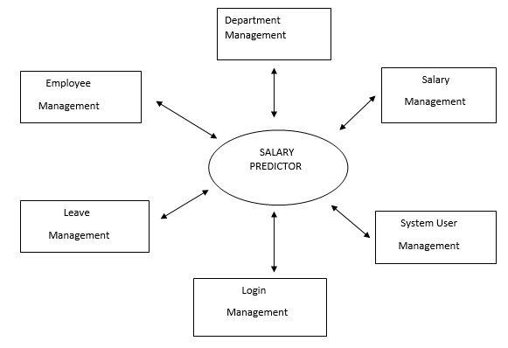
Context Diagram (Overall Project)
5
T011A/ Template Version 5.0

Slide 6
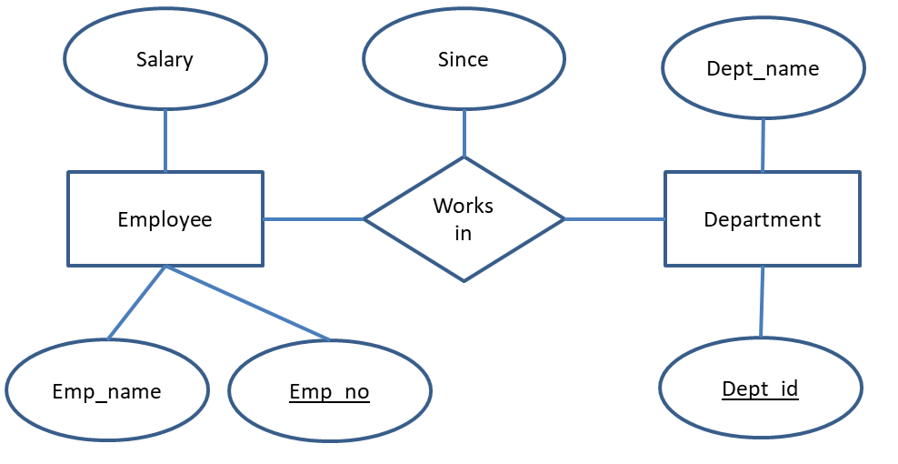
Entity Relationship Diagram (ERD)
6
T011A/ Template Version 5.0

Slide 7
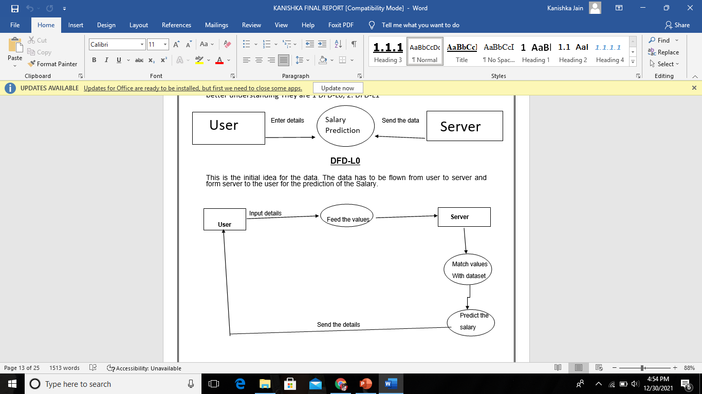
Data Flow Diagram (DFD)
DFD 0
Guidelines: Add more slides, if required to show all DFDs
7
T011A/ Template Version 5.0

Slide 8
Data Flow Diagram (DFD)
DFD 1
Guidelines: Add more slides, if required to show all DFDs
8
T011A/ Template Version 5.0

Slide 9
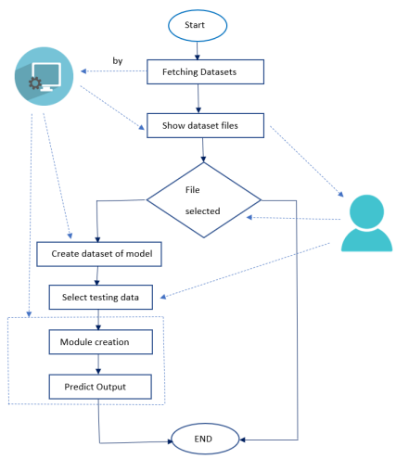
Flow Chart
Guidelines: This slide is optional
9
T011A/ Template Version 5.0

Slide 10
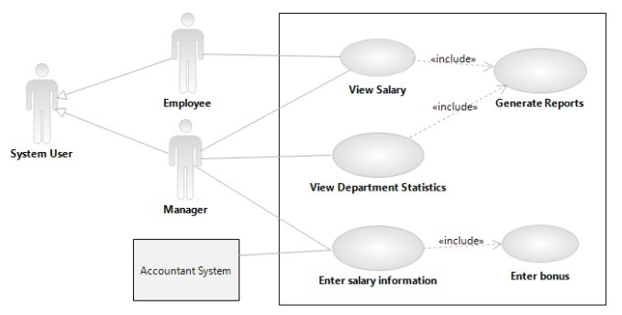
Use Case Diagram
Guidelines: This slide is optional. May add more slide, if the details are available
10
T011A/ Template Version 5.0

Slide 11
\
Advantage of The Project
Relatively simple to implement.
Scales to large data sets.
Guarantees convergence.
Can warm-start the positions of centroids.
Easily adapts to new examples.
Generalizes to clusters of different shapes and sizes, such as elliptical clusters.
Guidelines: Mention advantage from this project, the audience/ users who will get benefitted
11
T011A/ Template Version 5.0

Slide 12
References, if any
Book:- Introduction to machine learning
Course:- Machine Learning Master Course
Intern Shala:- Introduction to Machine Learning using Python
https://www.softwaretestinghelp.com/
https://discuss.appium.io/
https://stackoverflow.com/
12
T011A/ Template Version 5.0

Slide 13
THANK YOU

